Slide 1

Polish notations (Prefix & Postfix)
Muhammad Fahad
FA19-BSSE-0014

Slide 2

Objectives Overview
Notations
Prefix, Infix and Postfix Notations
Conversion of one type expression to another
Evaluation of Prefix and Postfix Notations

Slide 3

Notation
The way to write arithmetic expression is known as a notation. An arithmetic expression can be written in three different but equivalent notations, i.e., without changing the essence or output of an expression. These notations are:
Infix Notation
Prefix Notation
Postfix Notation

Slide 4
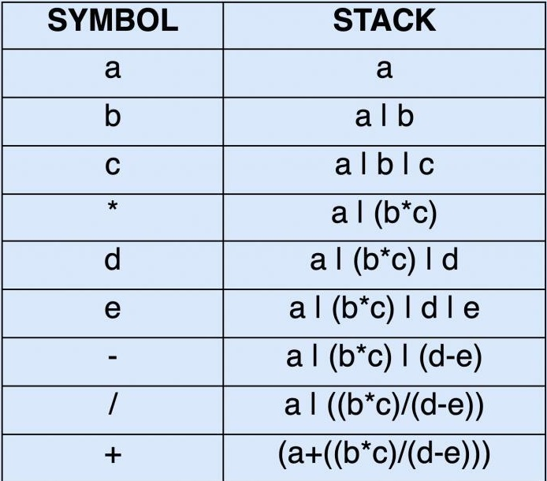
Infix Notation
Example
abc*de-/+ = (a+(b*c)/(d-e))
Simple Notation
We write expression in infix notation, e.g. a - b + c, where operators are used in-between operands. It is easy for us humans to read, write, and speak in infix notation but the same does not go well with computing devices. An algorithm to process infix notation could be difficult and costly in terms of time and space consumption.

Slide 5
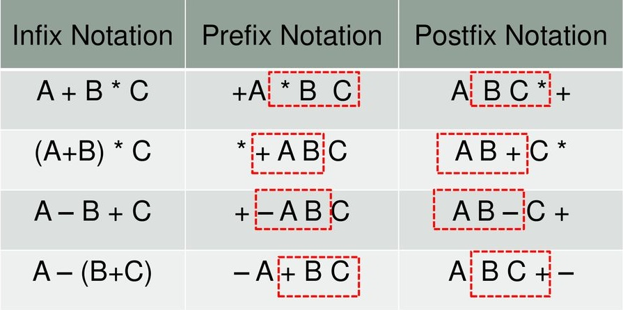
Title
Prefix Notation
Postfix Notation
In this notation, operator is prefixed to operands, i.e. operator is written ahead of operands. For example, +ab. This is equivalent to its infix notation a + b. Prefix notation is also known as Polish Notation.
This notation style is known as Reversed Polish Notation. In this notation style, the operator is postfix to the operands i.e., the operator is written after the operands. For example, ab+. This is equivalent to its infix notation a + b.
Basic Example

Slide 6

Title:
Next is the coding part….

Slide 7
THANK YOU
Muhammad Fahad

